Slide 1
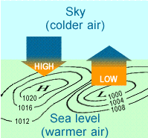
Notes:
*

Slide 2
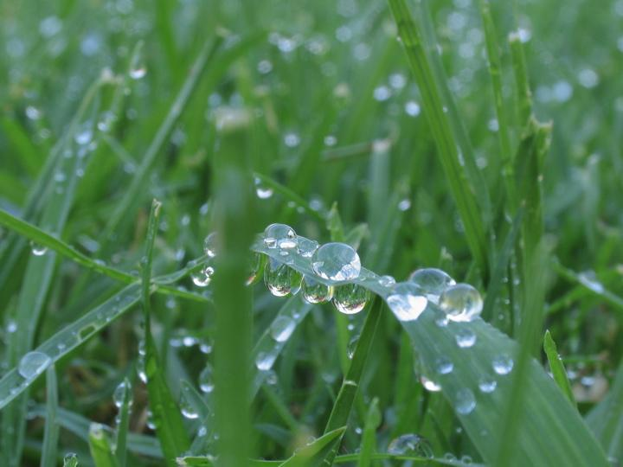
Dew point is the temperature to which a parcel of air would need to be cooled to
reach saturation.
Notes:
*

Slide 3
Wind is a result of horizontal differences in air pressure
Air flows from areas of high pressure to areas of lower pressure.
Notes:
*

Slide 5
 | Low Pressure Centers | High Pressure Centers
Air | Sinking | Rising
Pressure Behavior | Pressure drops Cyclone | Pressure increase Anticyclone
Wind Behavior | Winds blow counterclockwise | Winds blow outward and clockwise
Weather Associated | Severe and stormy | Fair and Sunny
Symbol | “L” that is RED | “H” that is BLUE
Notes:
*

Slide 6
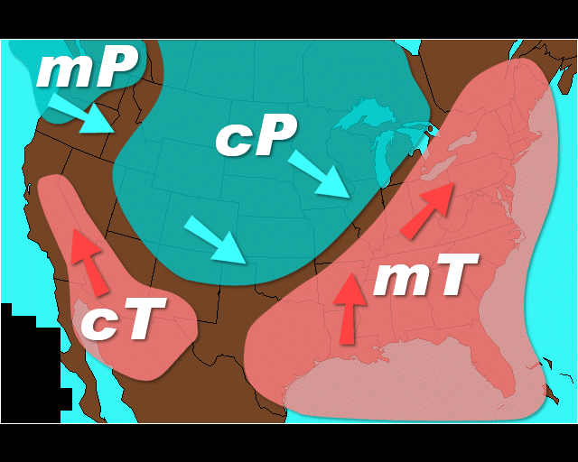
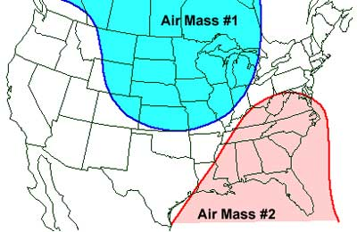
Air Mass
Air mass is an immense body of air that is characterized by similar temperatures and amounts of moisture at any given altitude

Slide 7
Classifying Air Masses
Air masses are classified by temperature and surface area over which they form

Slide 8
Classifying Air Masses
NAME P – Polar | LOCATION High Latitudes towards the poles | TEMPERATURE Cold Temps
T – Tropical | Low Latitudes towards the equator | Warm Temps
C – Continental | Over land mass | Cold or warm, depending on the latitude
M – Maritime | Over water | Cold or warm, depending on the latitude

Slide 9
Four Basic Types of Air Masses
cP – Continental Polar dry and cool cold and dry in winter and summer | cT – Continental Tropical dry and warm hot, drought-like conditions
mT – Maritime Tropical wet and warm source of precipitation in the United States | mP – Maritime Polar wet and cold mild, humid, unstable cold air from Canada

Slide 11
Isobars
lines on a map that connect places of equal air pressure
A pressure gradient
The spacing of isobars indicates the amount of pressure change over a given time
Notes:
*

Slide 12
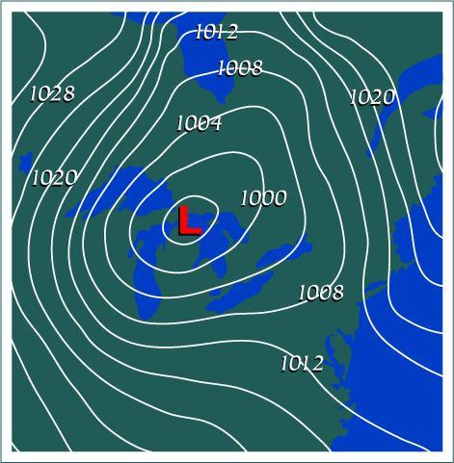
Closely spaced isobars: indicate a steep pressure gradient and high winds.
Widely spaced isobars: indicate a weak pressure gradient and light winds.
Notes:
*

Slide 13
 | Cold Front | Warm Front | Stationary Front | Occluded Front
Symbol
Profile/ Description
Weather

Slide 14
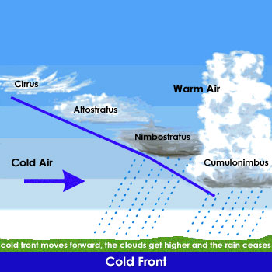
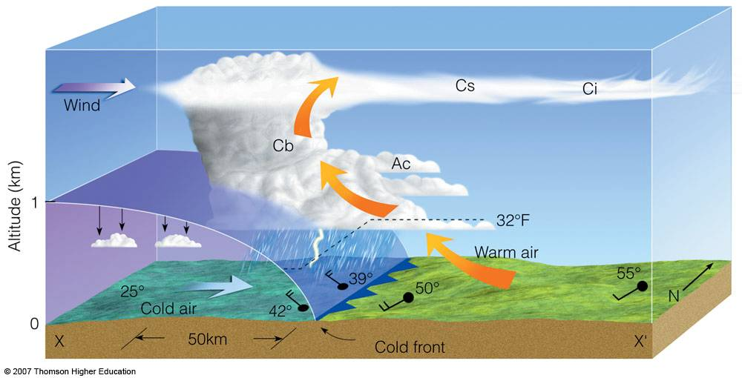
Cold Front
Cold air mass moves into an area occupied by warmer air.
Weather Conditions: Thunderstorms, Rain

Slide 15
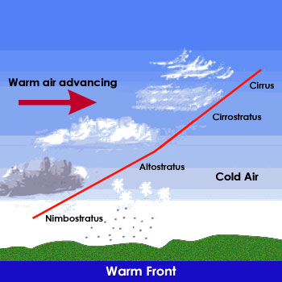
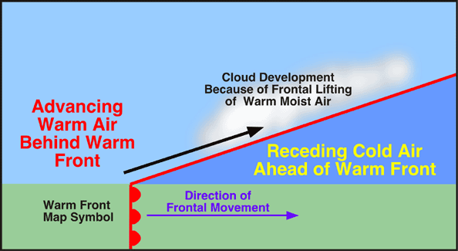
Warm Front
A warm front – warm air moves into an area formerly covered by cooler air
Warm air glides up over a cold, dense air mass
Weather Conditions: Light to moderate rain

Slide 16
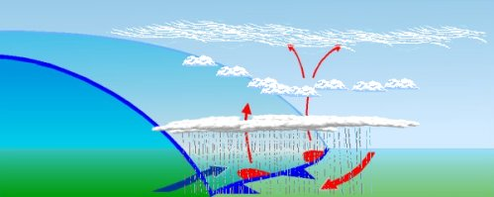
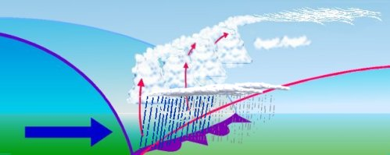
Stationary and Occluded Fronts
stationary front: The surface position of the front does not move
Weather: steady rain for days
occluded front: when an active cold front overtakes a warm front
Weather: stormy

Slide 17
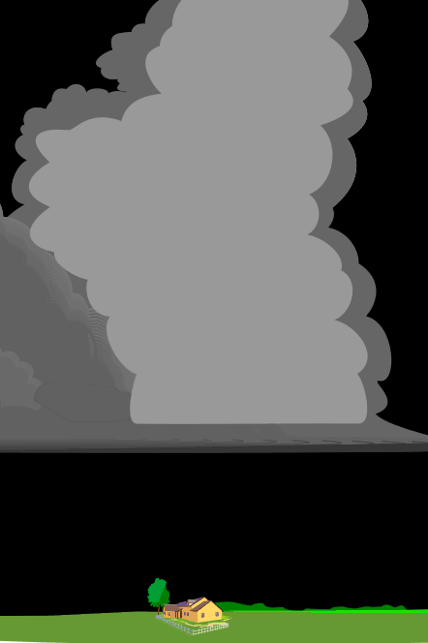
Thunderstorms
Is a storm that generates thunder and lightning
Frequently produces gusty winds, heavy rain, and hail
Associated with cumulonimbus clouds

Slide 18
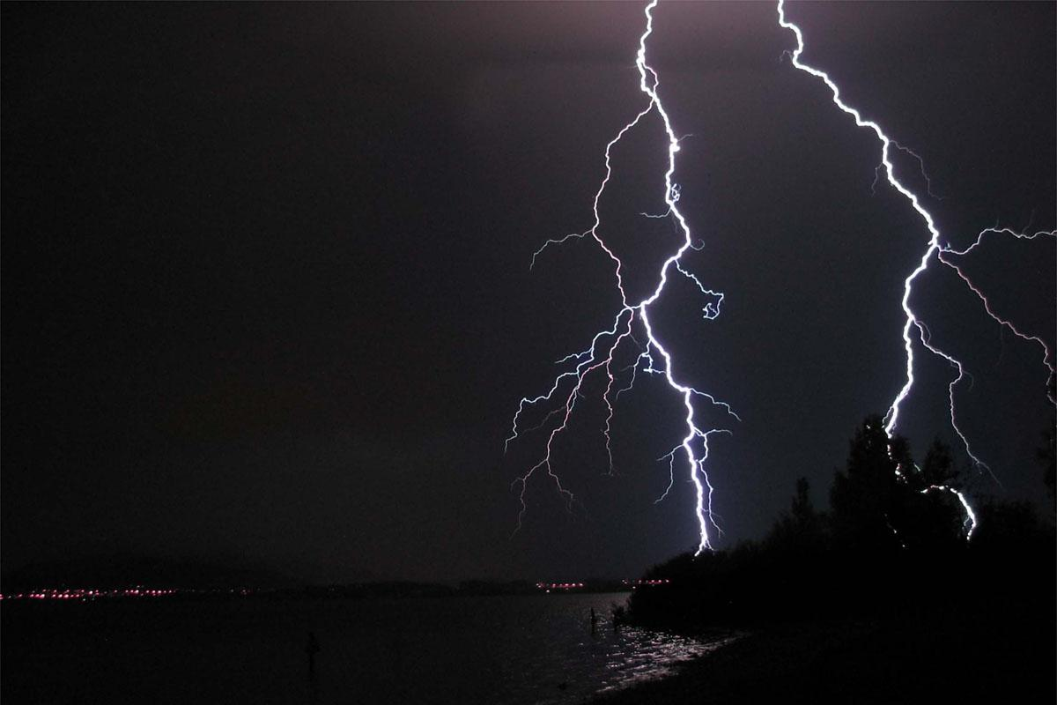
Lightning: results from the build-up and discharge of electric energy between positively (ground) and negatively (clouds) charged area
Thunder: the sound of rapidly expanding gases usually associated with lightning

Slide 19
Occurrence and Development of Thunderstorms
Occurrence
At any given time, there are an estimated 200 thunderstorms in progress on Earth
Mostly in the tropics
Development
Thunderstorms form when warm, humid air rises in an unstable environment
Three Stages
Cumulus: build-up of clouds and moisture
Mature: Heavy rain fall, most active time
Dissipating: light rain, storm is calming down

Slide 20
Tornadoes - violent low pressure windstorms that take the form of a rotating column of air (vortex).
The vortex extends downward from a cumulonimbus cloud producing rain and hail
Move counterclockwise

Slide 21
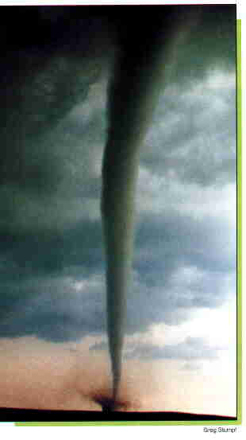
Occurrence, Development, and Intensity of Tornadoes
Occurrence
770 occur each year
Tornado Season
April to June
Associated with severe thunderstorms
Intensity
Fujita Tornado scale
Based on the amount of damage

Slide 22
Fujita Tornado Scale
Category | Winds (MPH) | Winds (KPH) | Damage
F0 | <73 | <116 | Light damage
F1 | 73-112 | 116-180 | Moderate Damage
F2 | 113-157 | 181-254 | Considerable Damage
F3 | 158-206 | 254-332 | Severe Damage
F4 | 207-260 | 333-419 | Devastating Damage
F5 | >260 | >419 | Incredible and Speechless Damage

Slide 23
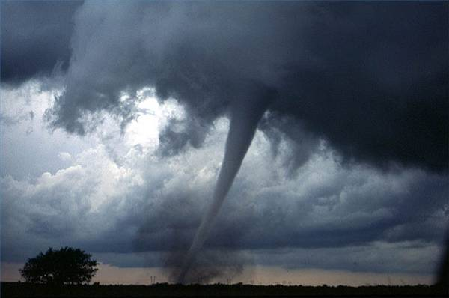
Tornado Warnings vs. Watches
Watches : Possibility of a tornado to be developed in the area
Warning: Tornado has been seen by people or indicated by radar

